Slide 1
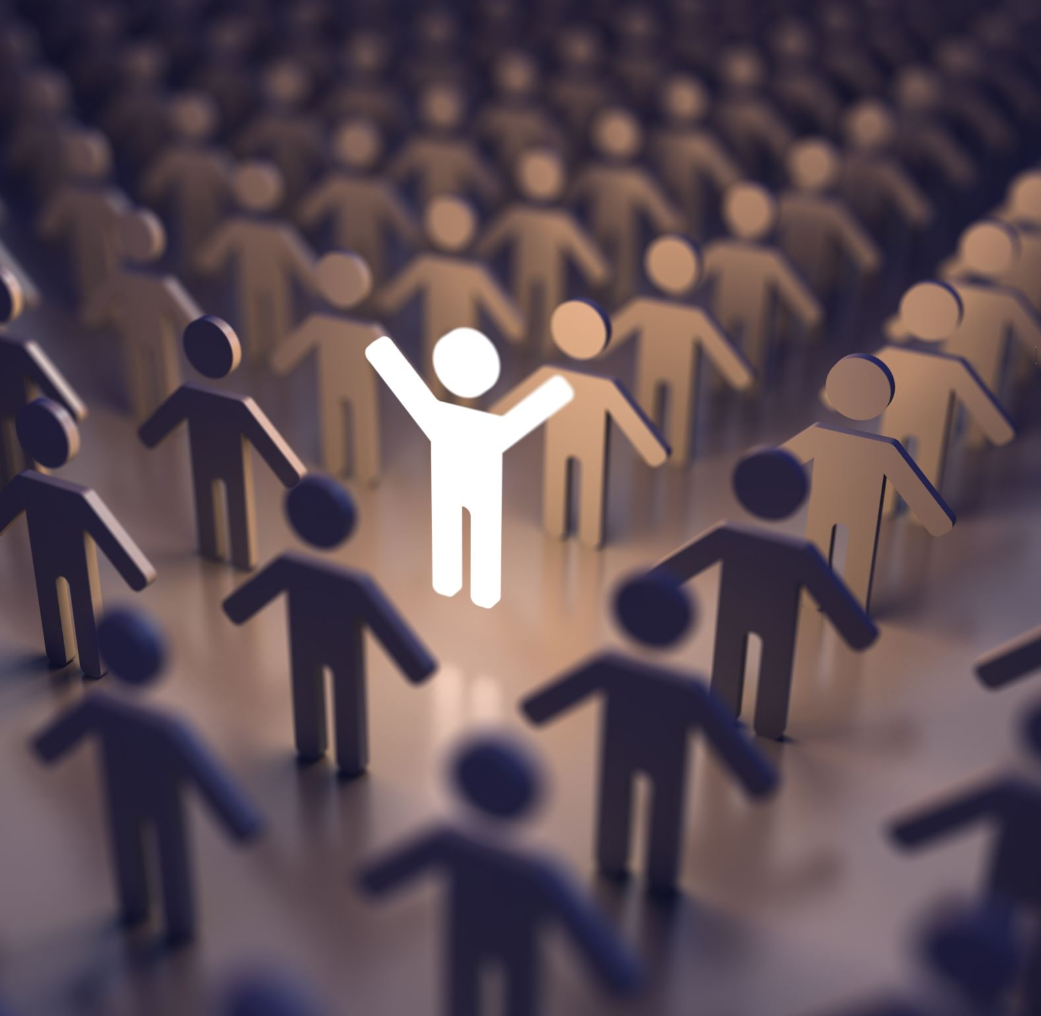
Human 2.0
presented by Armin Schneider

Slide 2
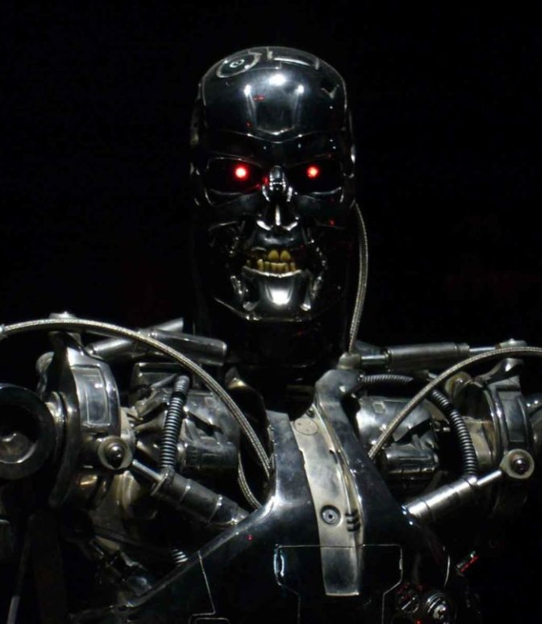
Overview
Who is Ray Kurzweil?
Are we merging with technology?
Possible downsides?
What are we already using?

Slide 3
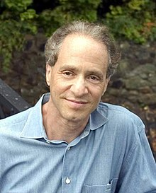
Ray Kurzweil
Born in: February 12, 1948 (age 74)
Inventions:
optical character recognition
speech recognition
Books:
“The Singularity is Near: When Humans Transcend Biology”
“The Age of Spiritual Machines”
2005

Slide 4
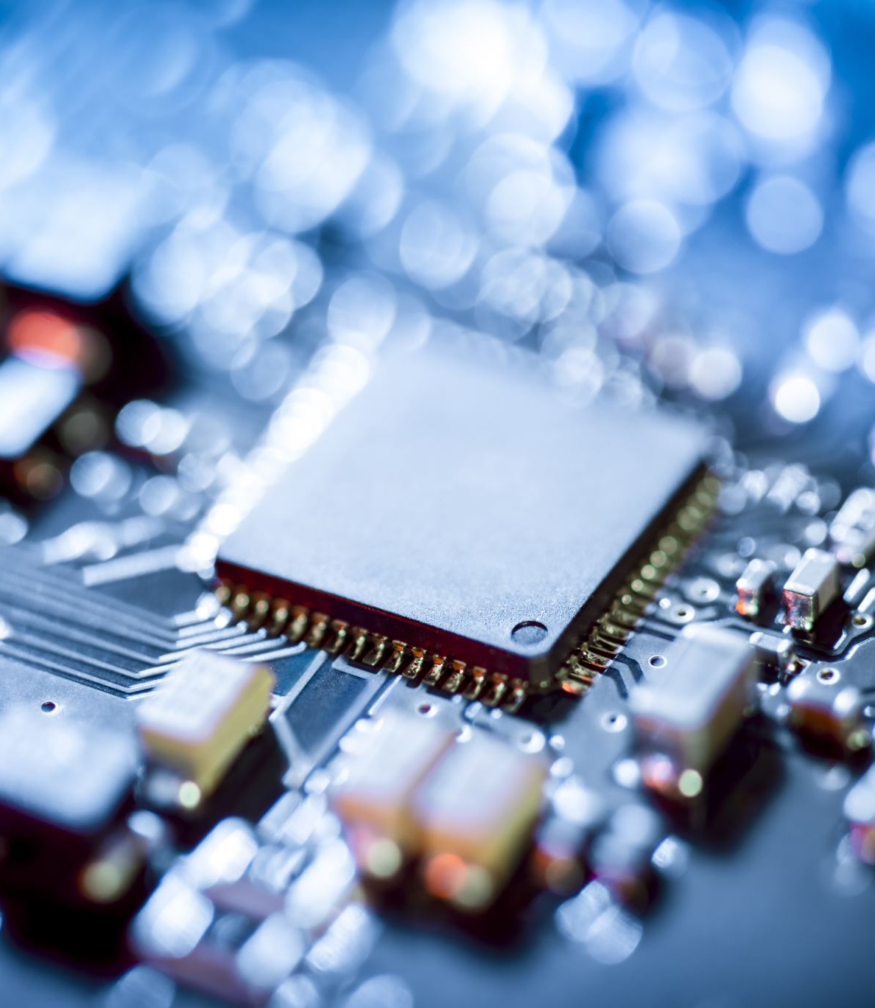
Are we merging with technology?
Controlling machines with your mind
Paying with an “in-built” chip
Being stronger, faster and “repairable”

Slide 5
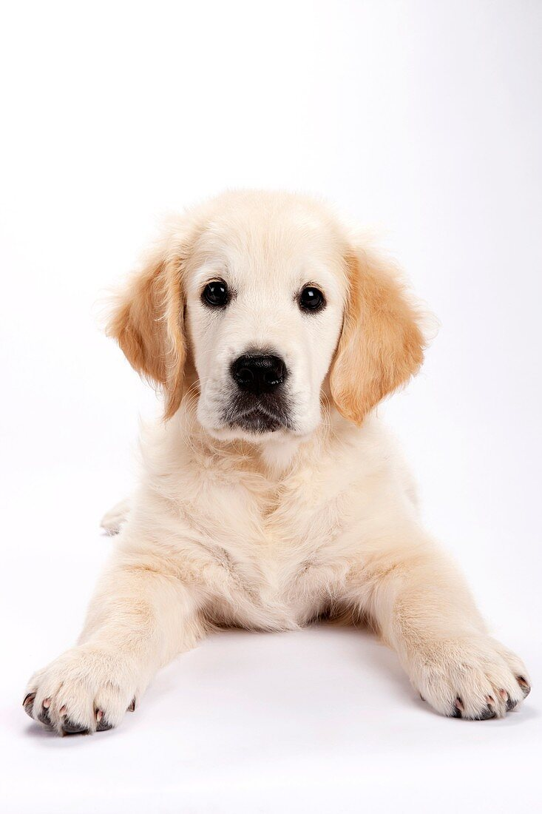
Life 1.0
Create and replicate
They can not redesign themselves

Slide 6
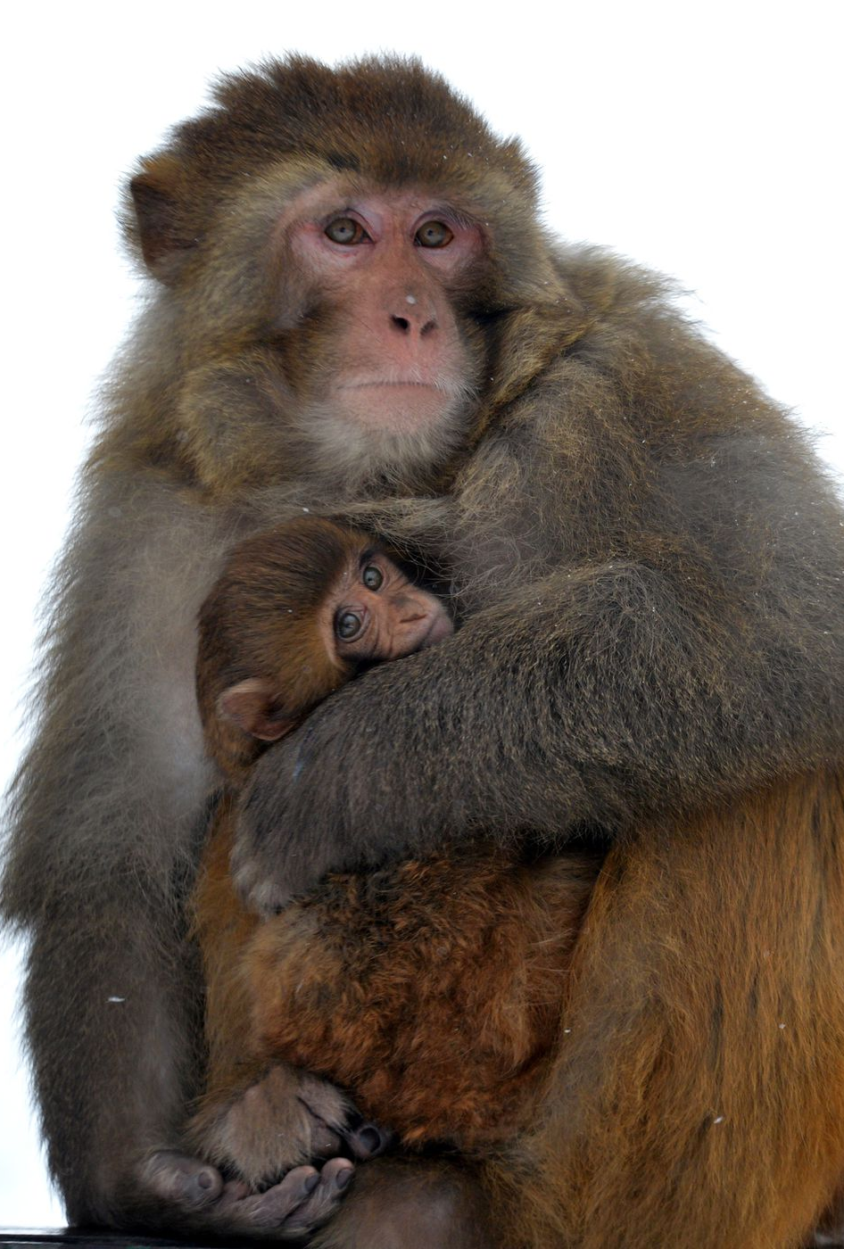
Lifeforms between 1.0 & 2.0
Use tools
Culture

Slide 7
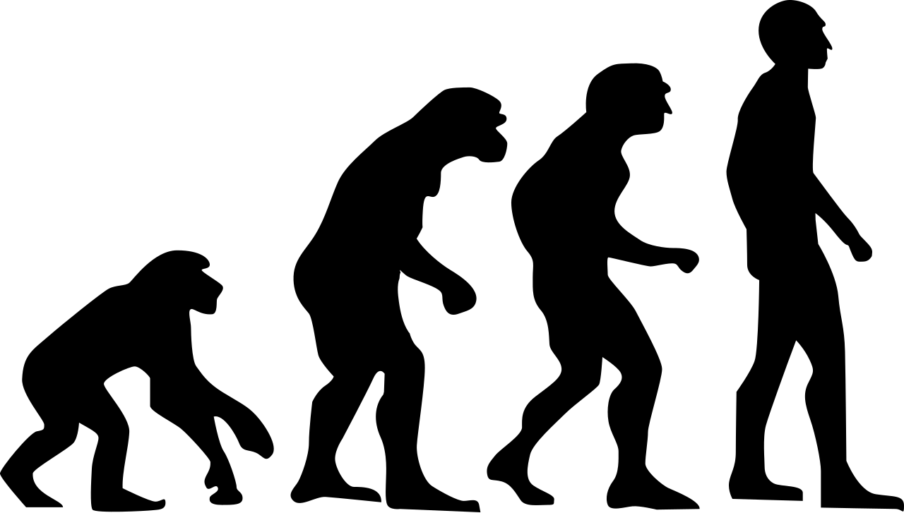
Life 2.0
Extensive language
Social intelligence
Independent of genetic constraint

Slide 8
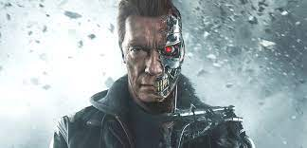
Life 3.0
Does not exists yet
Can redesign its hard- & software

Slide 9
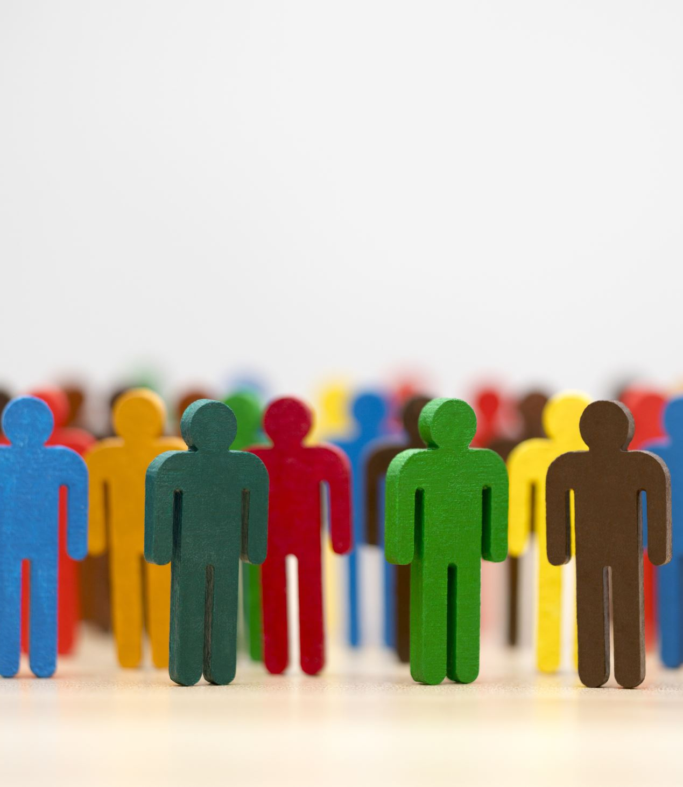
Possible Downsides
A gap in society
Big difference between rich and poor

Slide 10
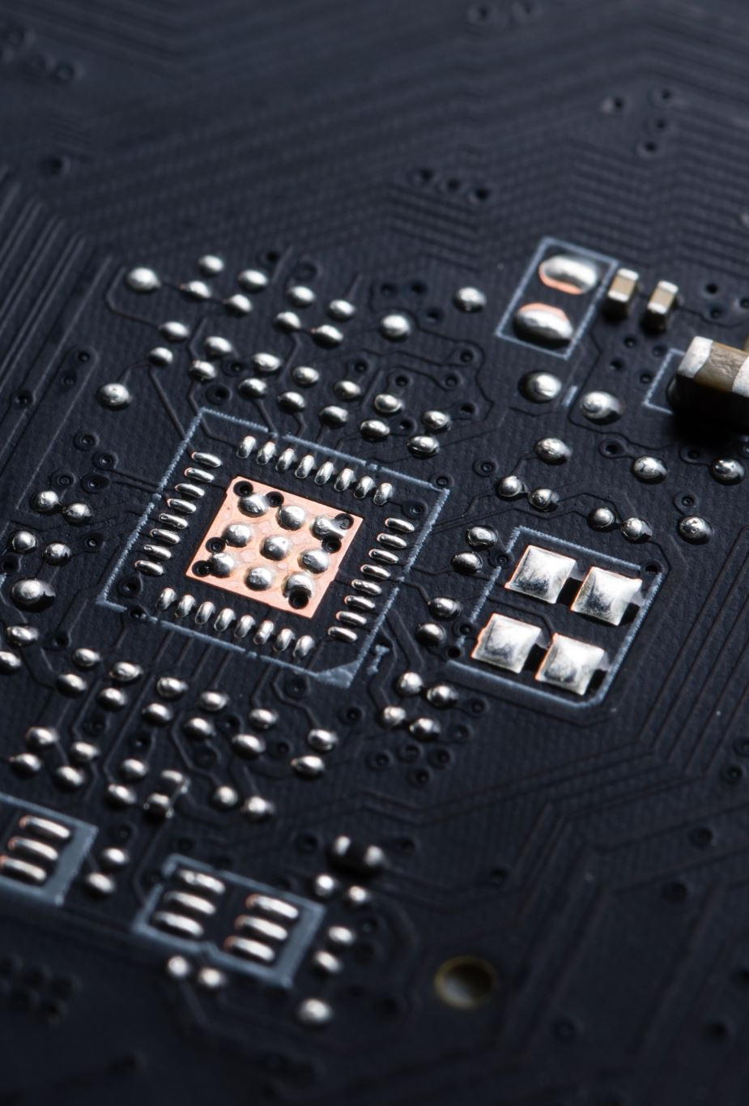
What‘s already here?
Microchips under the skin
Soon Elon Musks „Neuralink“
Brain controlled prosthesis

Slide 11

Thank you for your attention

